Slide 1
Team 516
Lunar Dust Glovebox
Design Review 4
January 30, 2025
Notes:
Good afternoon everyone, We are Team 516 and today we will be talking about our design and progress for the Lunar Dust Glovebox Project

Slide 2
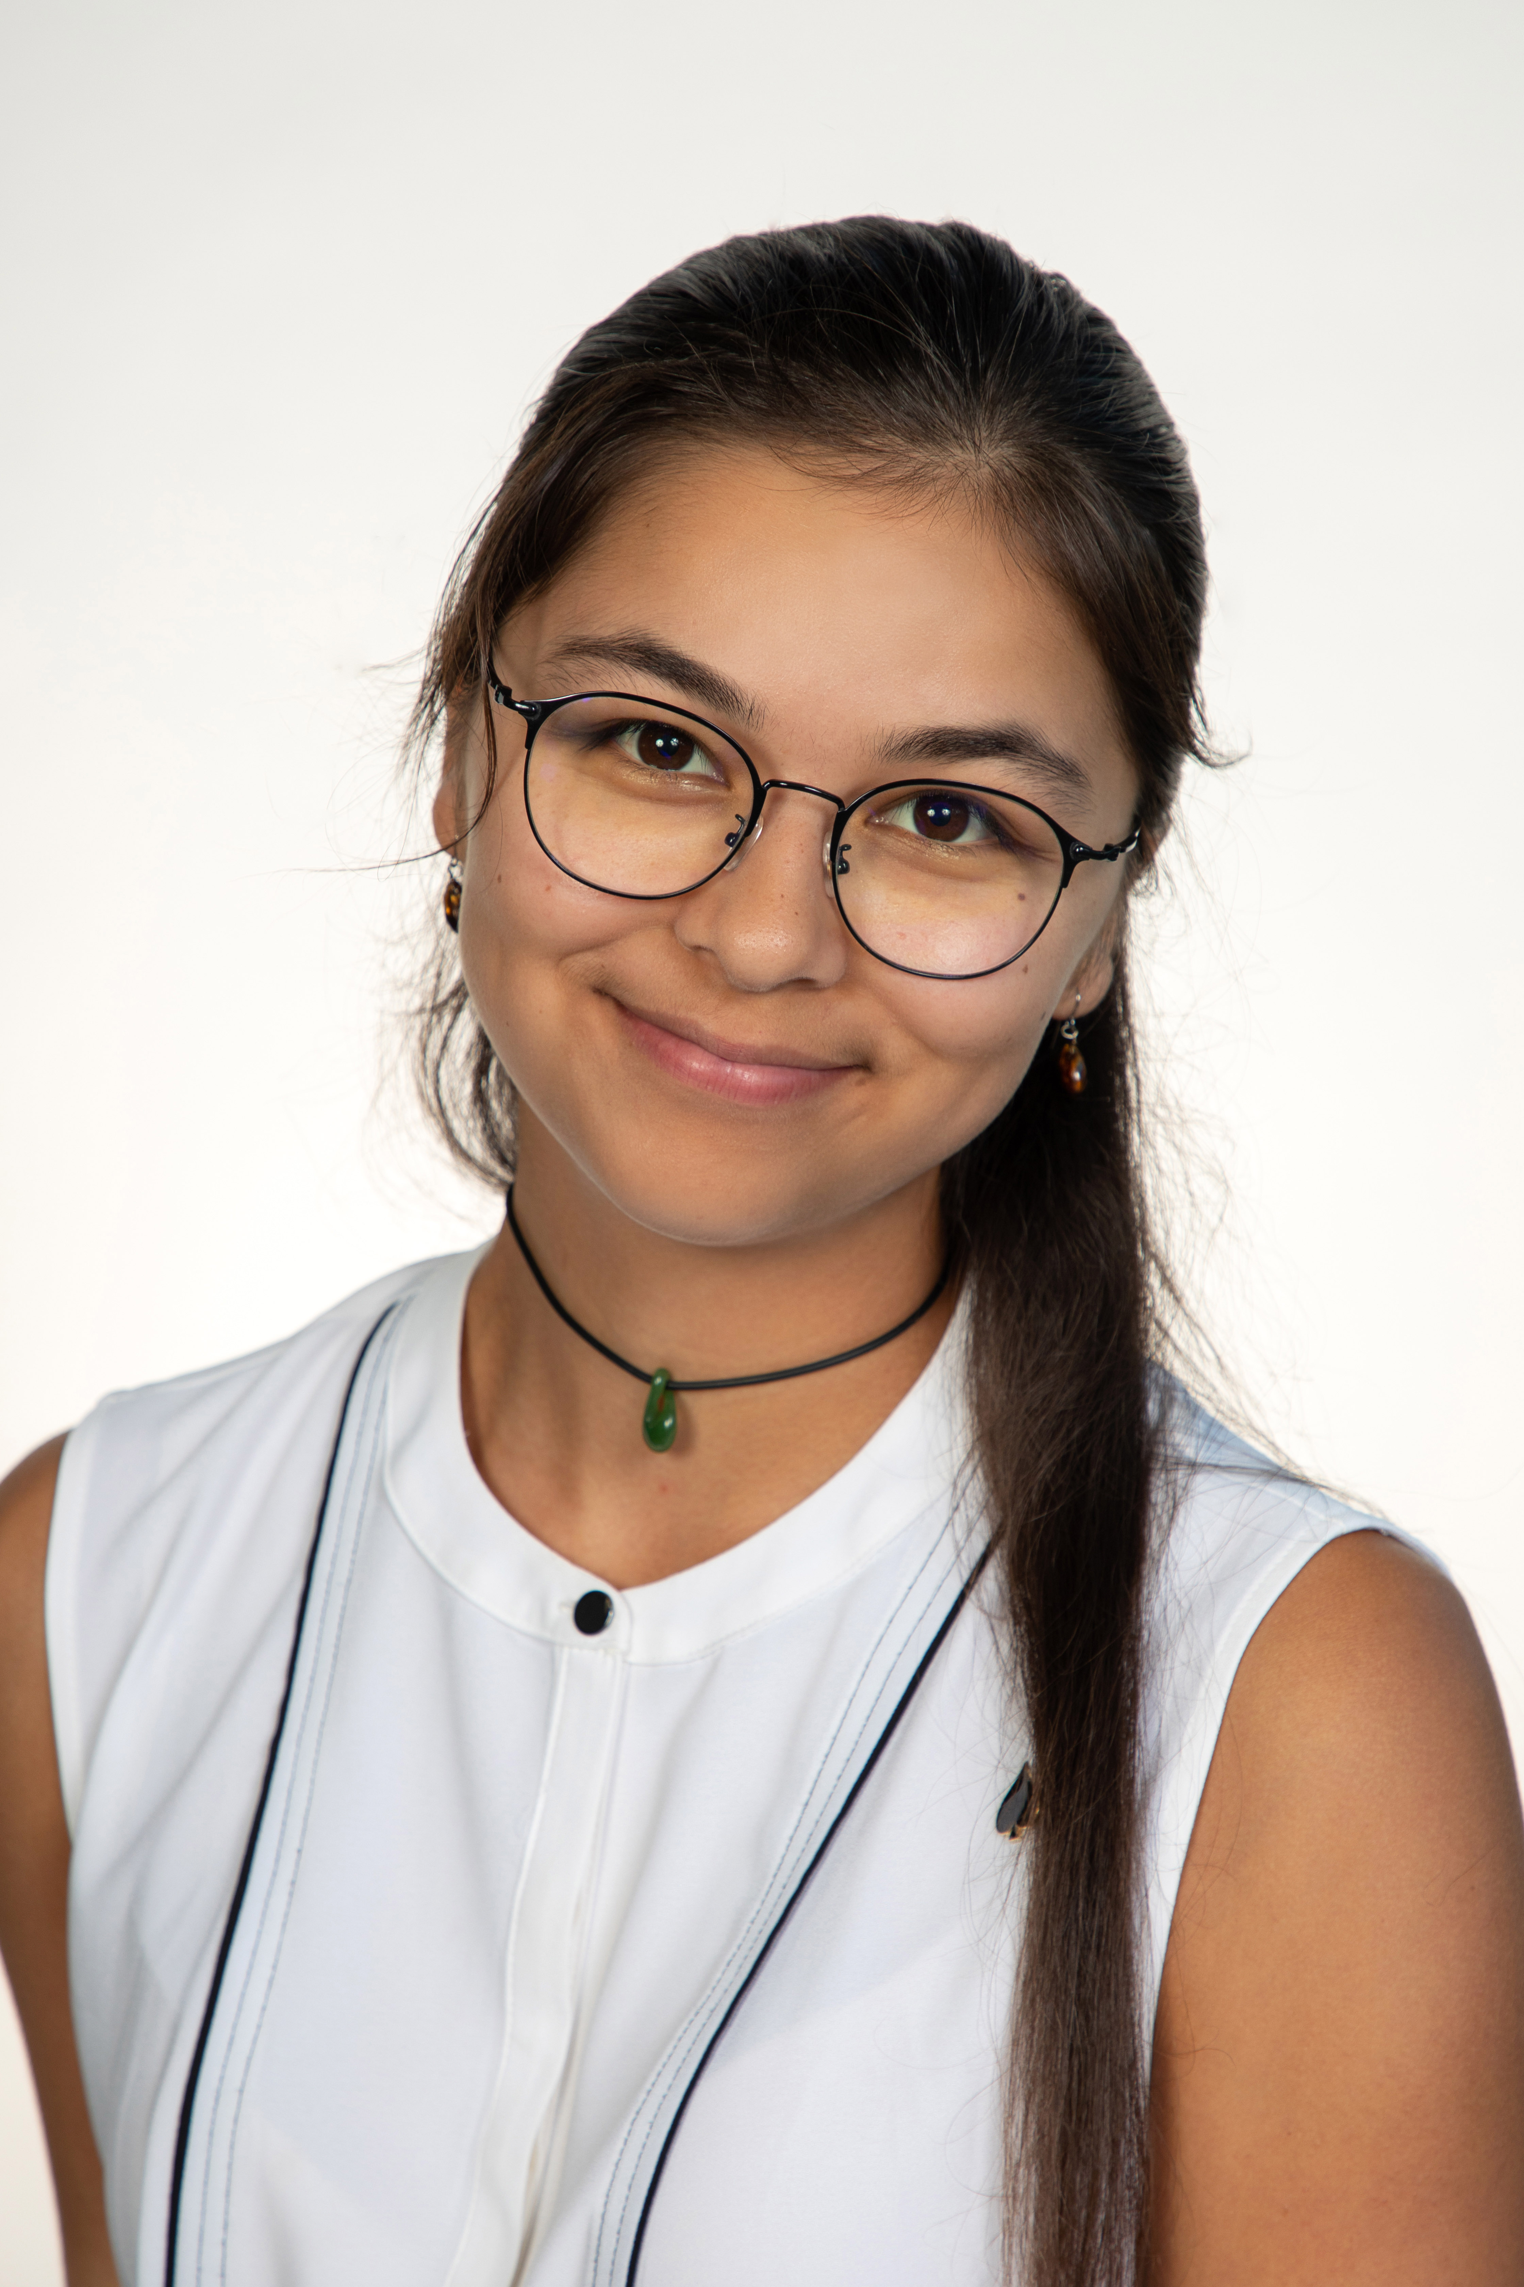
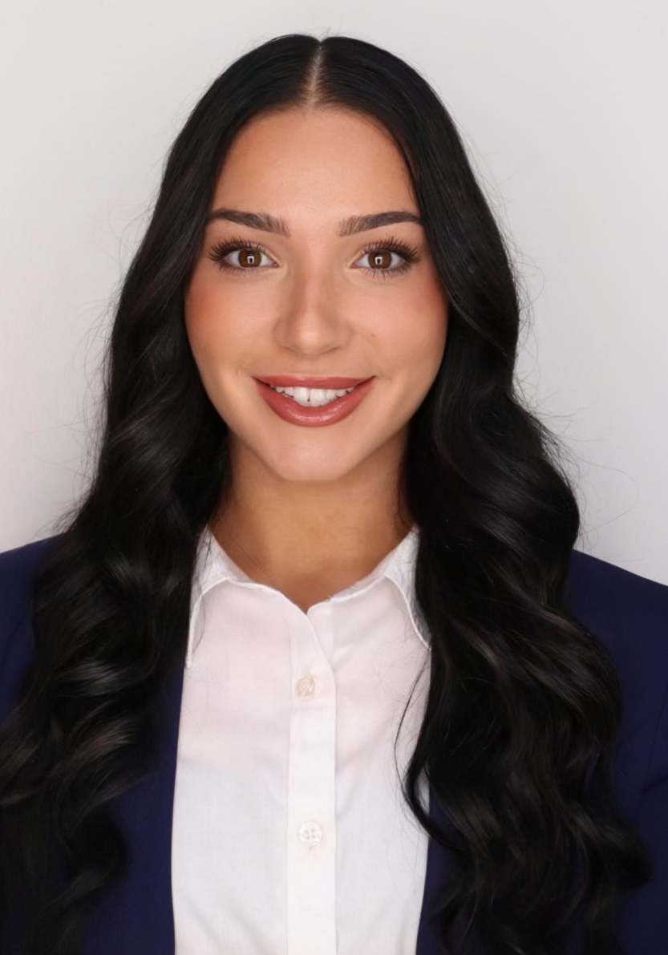
Our Team
All
Presenter
Nia Britton
Manufacturer
Kendall Kovacs
Simulant Specialist
Lawrence Terrell
CFD Analyst
Mina Brahmbhatt
Manufacturer
Ryan Dreibelbis
CFD Analyst
Peter Mougey
Manufacturer
Presenter
2
Presenter
Notes:
Im mina, im nia, im ryna, im kendall, im peter, and im lawrence

Slide 3
Sponsors
Nia Britton
Amy Cassady
Orion Integrated Performance Lead
Amy Fritz
JSC Dust Mitigation Technical Lead
Brian Troutman
Human Landing System Crew Compartment Lunar Dust Mitigation Discipline Lead
Thomas Vassiliou
EX2 Spacecraft Performance and Concept Engineering (SPACE) Acting Deputy Branch Chief
Notes:
Here are our sponsors, both the Amy’s, brian (our main point of contact) and thomas

Slide 4
Advisors
Nia Britton
Dr. Brandon Krick Associate Professor
Dr. Shayne McConomy
Teaching Faculty II
Notes:
And here are our advisor, both dr krick and dr mcconomy

Slide 5
Objective
Nia Britton
The objective of this project is to optimize air flow to evenly distribute lunar dust simulant throughout a lunar dust glovebox.
Notes:
The objective of our project is pretty straightforward, to optimize air flow to evenly distribute lunar dust simulant throughout a lunar dust glovebox

Slide 6
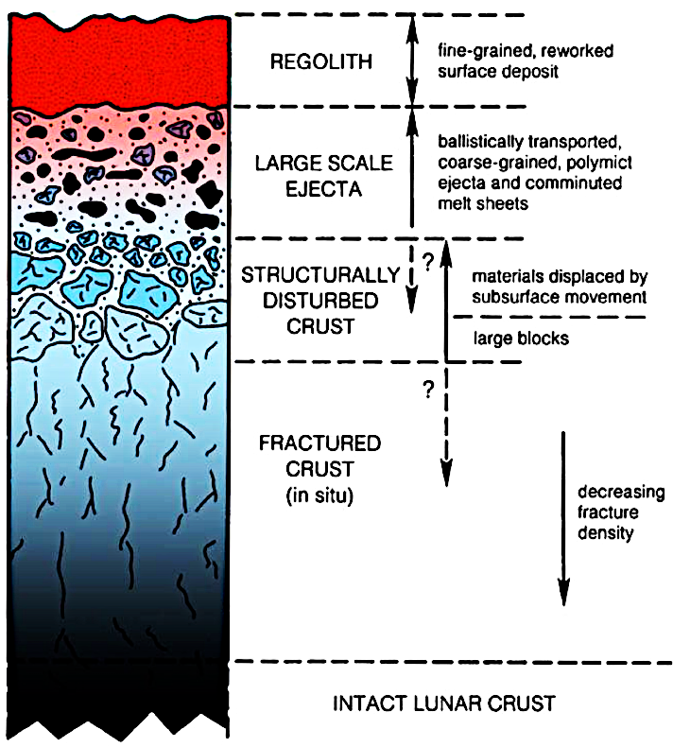
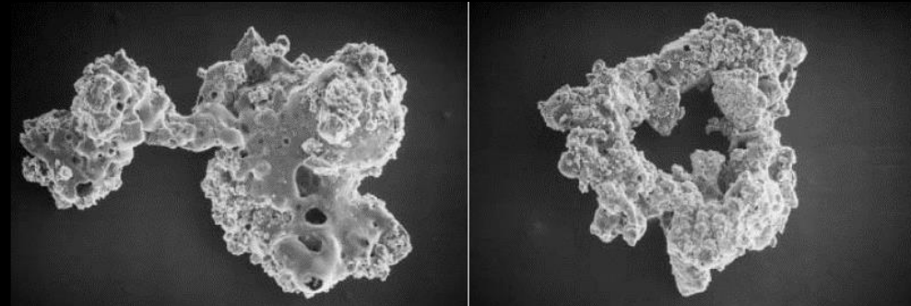
Project Background:
Lunar Regolith
Nia Britton
Fragmental layer covering the lunar surface
Independent of rock size or composition
Notes:
-lunar regolith is the fragmental layer covering the surface of the moon, independent of rock size or composition. The picture below the text is the cross section of the regolith structure and the microstructure; showing how its irregular boundaries make it sharp. The image on the right side shows the different layers of lunar regolith, showing that the closer you get to the surface, the more fine and course it gets.

Slide 7
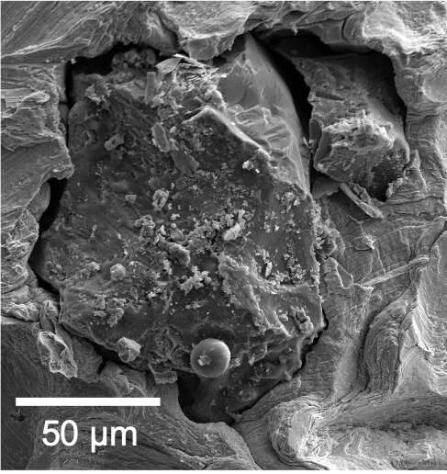
Project Background:
Lunar Dust
Nia Britton
Fine particles of the lunar regolith
Average size is ~100 µm
Average bulk density is 1.5 g/cm³
Notes:
The particles jagged edges and irregular shape is what leads to it being so harmful to mechanisms and humans. These particles can be very fine, with an average size of around 100 nanometers and bulk density of one point five grams per centimeter cubed

Slide 8
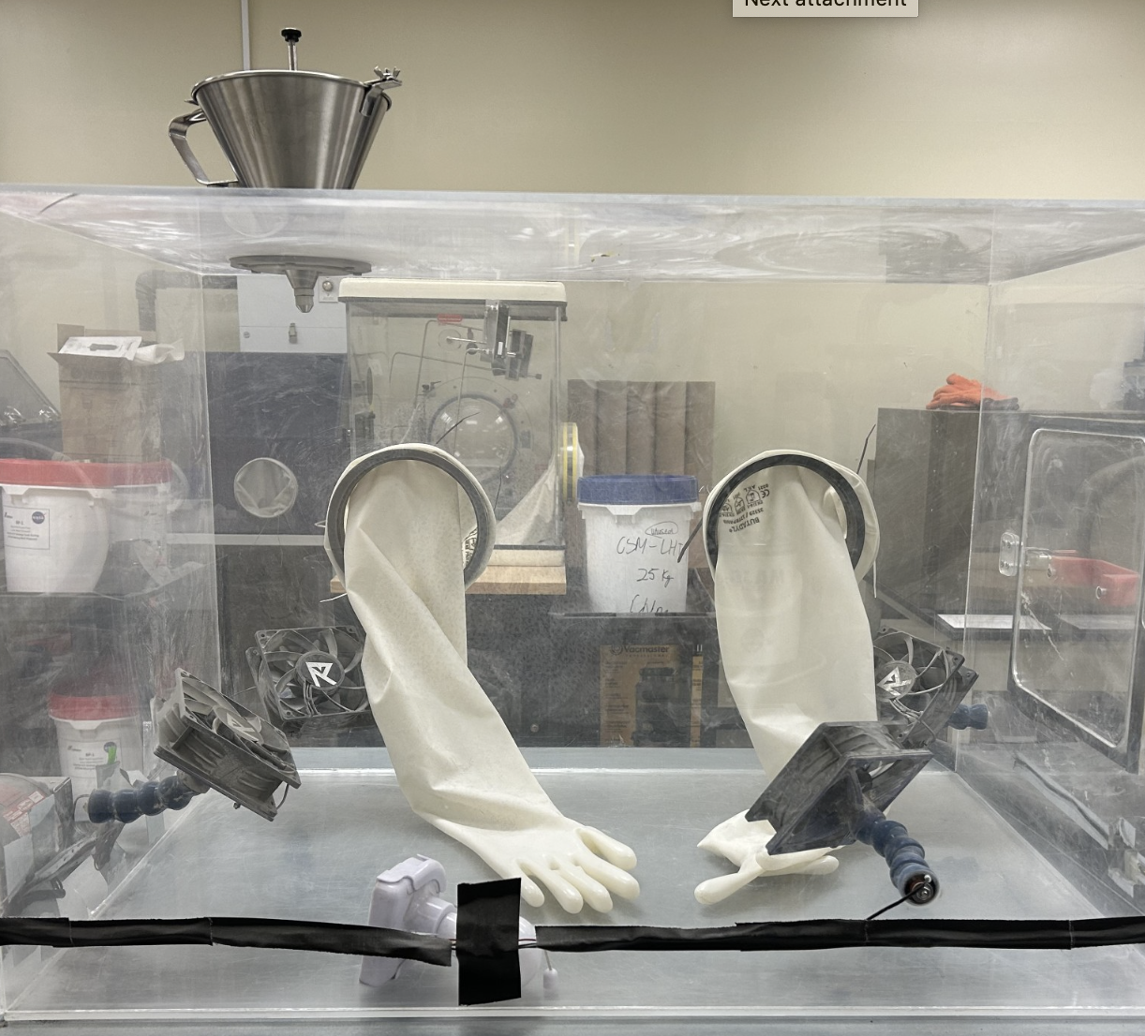
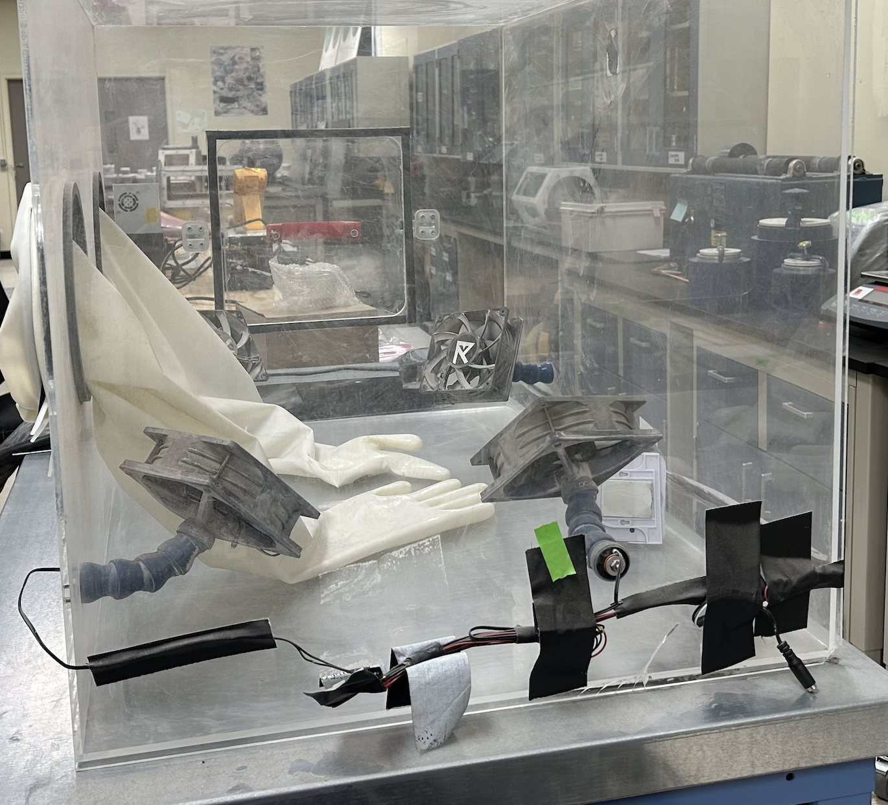
Project Background:
NASA-JSC & ASEG Glovebox
Nia Britton
Notes:
Here we have the original glovebox that NASA has created and been using. We have been told to use this protype as a sort of base for our recreation, sans gloves.

Slide 9
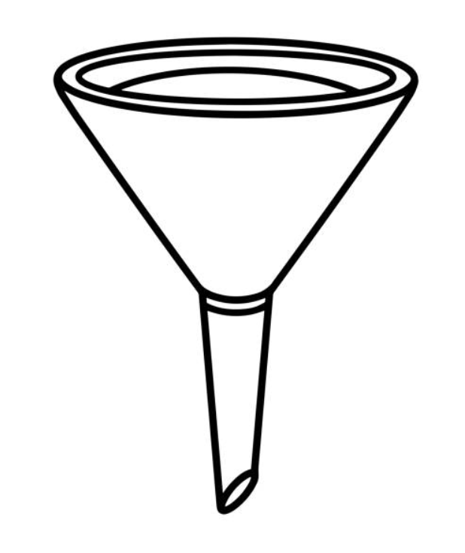
Project Background:
The Problem
Peter Mougey

Slide 10
Project Background:
The Problem
Peter Mougey

Slide 11
Project Background:
Overall Goals
Peter Mougey
Model air flow using CFD
Design and test glovebox design
Compare result with CFD

Slide 12
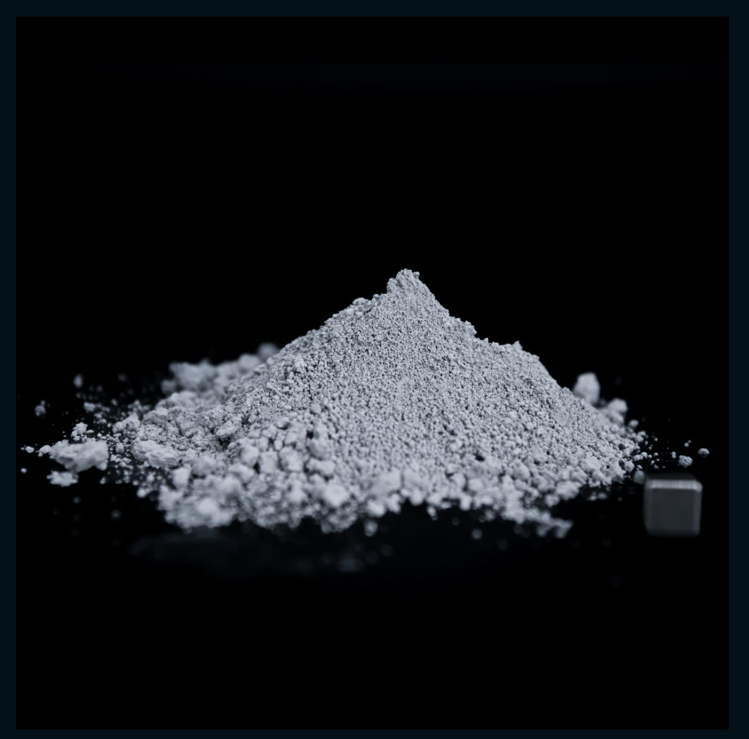
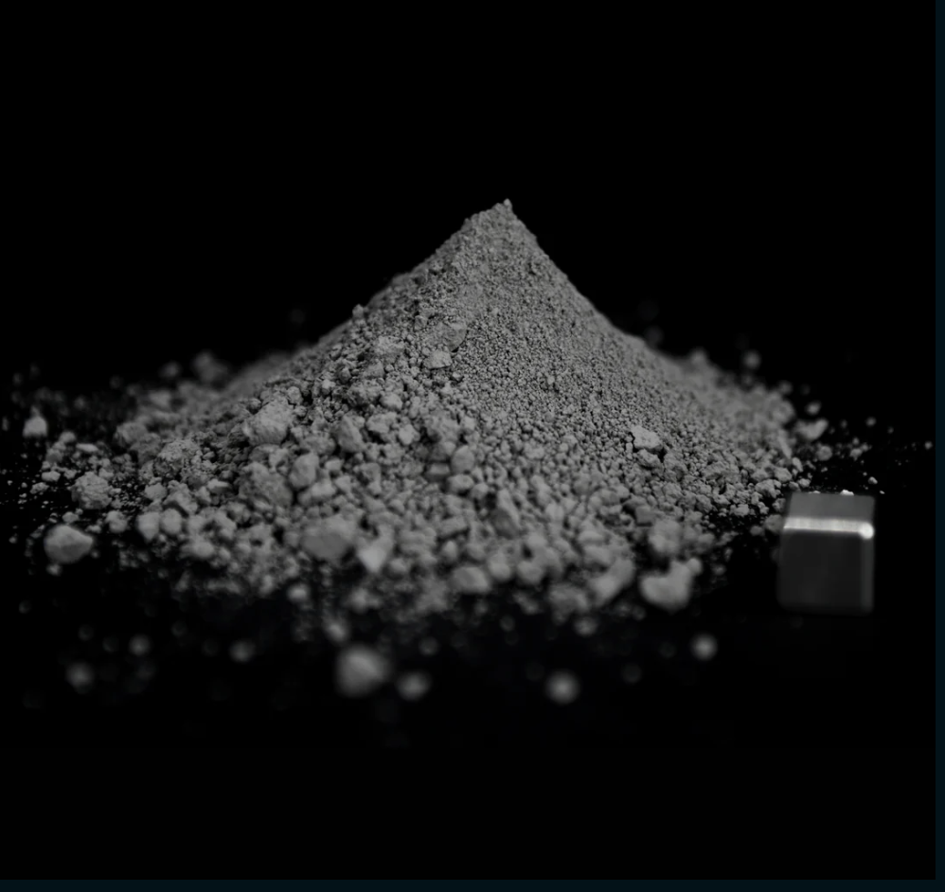
Selected Simulants:
Characteristics & Differences
Peter Mougey
LHS-1:
Lunar Highlands Dust Moon Simulant
LMS-1:
Lunar Mare Dust Moon Simulant
Notes:
-Highlands is from the lighter part of the moon
-Mare is from the darker side of the moon
-Chose these because they fit the criteria for density needs (below 35 um) and they both come from the same company called Space Resource Technology
-IF ASKED: since we switched from LHS-1 to LHS-1D, the difference is a smaller particle diameter of 35 microns compared to 1 mm

Slide 13
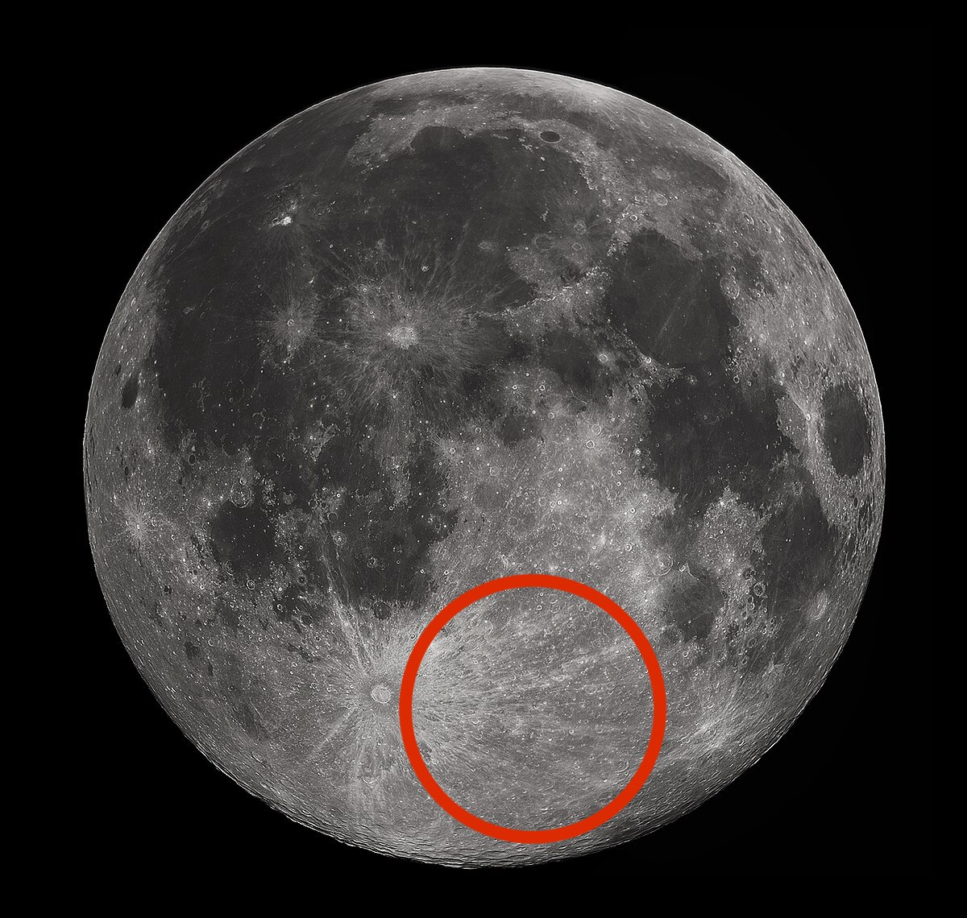
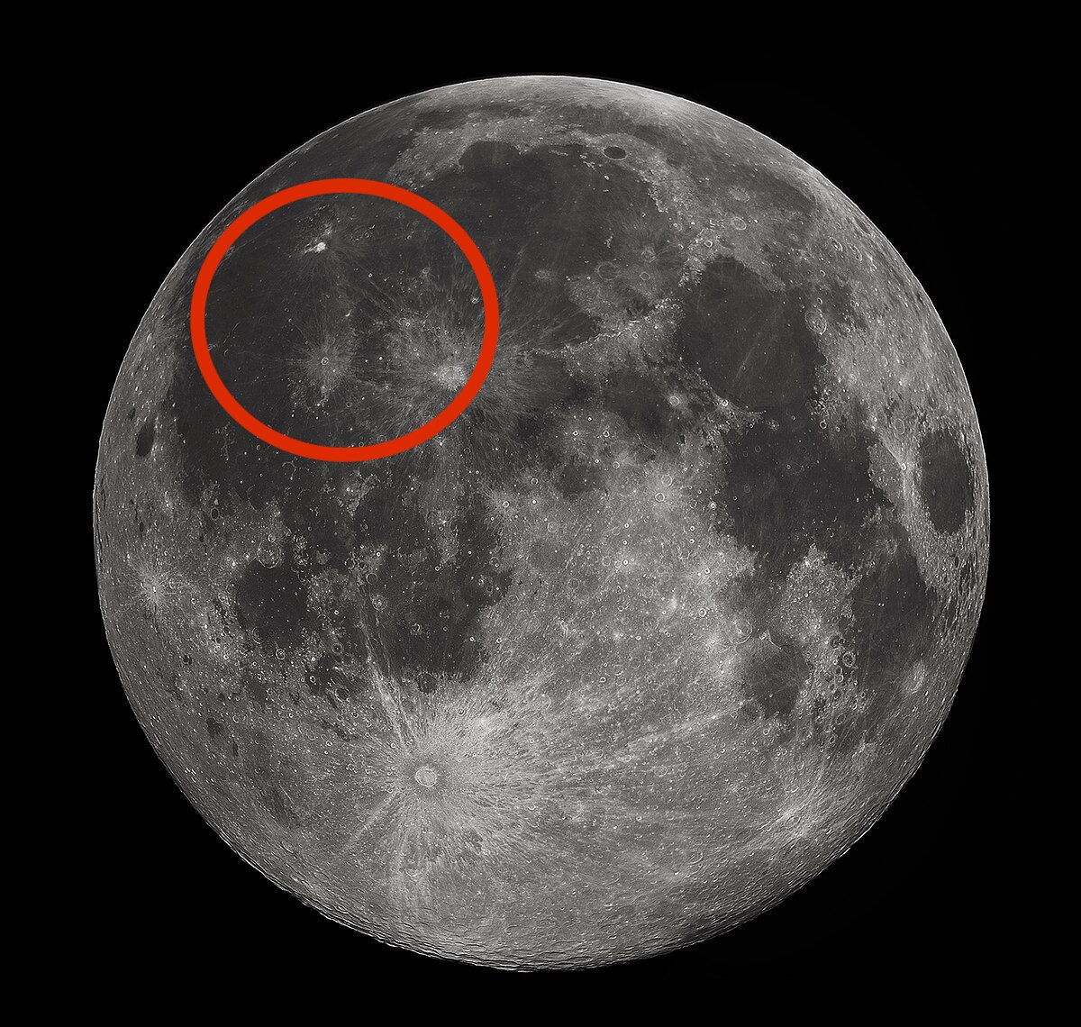
Selected Simulants:
Characteristics & Differences
Peter Mougey
LHS-1:
Lunar Highlands Dust Moon Simulant
LMS-1:
Lunar Mare Dust Moon Simulant
Notes:
-Highlands is from the lighter part of the moon: mainly anorthsite formed from slowly cooled lava
-Mare is from the darker side of the moon: mainly dark basalts formed from rapid cooled lava
-Chose these because they fit the criteria for density needs (below 35 um) and they both come from the same company called Space Resource Technology

Slide 14
Selected Simulants:
Properties and Shipping
Peter Mougey
LHS-1:
Lunar Highlands Dust Moon Simulant
LMS-1:
Lunar Mare Dust Moon Simulant
Order Size: 100g
Particle size range: <106 µm
Uncompressed bulk density: 1.56 g/cm³
Mineralogically Accurate
Material Density: 3.27 g/ cm³
Order Size: 100g
Particle size range: <106 µm
Uncompressed bulk density: 1.27 g/cm³
Mineralogically Accurate
Material Density: 3.17 g/cm³
Notes:
-Highlands is from the lighter part of the moon
-Mare is from the darker side of the moon
-Chose these because they fit the criteria for density needs (below 35 um) and they both come from the same company called Space Resource Technology
-Uncompressed bulk density is just the density that assumed zero outside pressure is acting on it

Slide 15
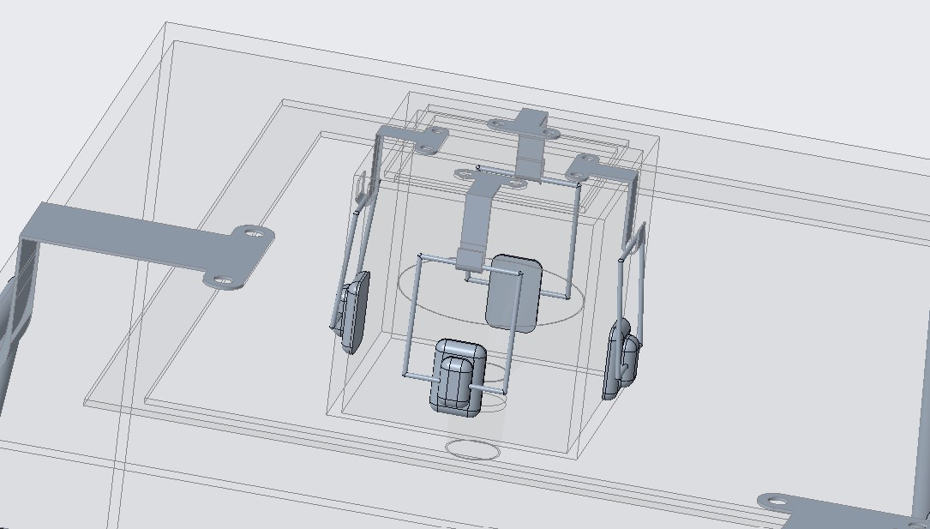
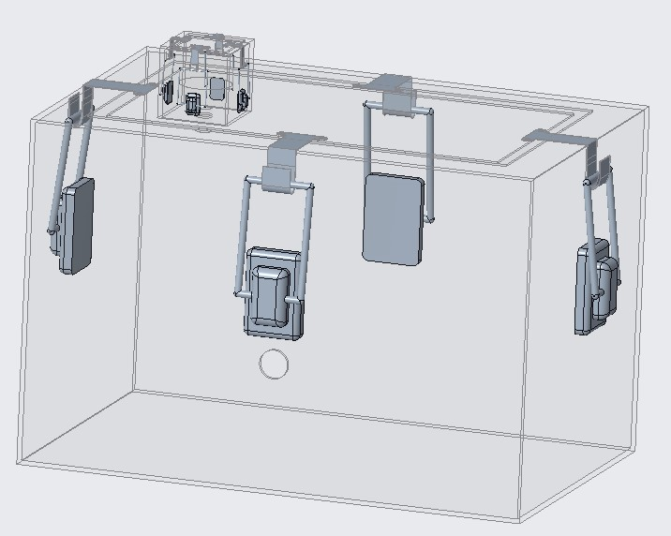
Design Concept: CAD Model
Peter Mougey
Notes:
Here is a final draft of the glovebox design we want the machine shop to craft for us, with a spot for vacuum testing, a main box enclosure, a funnel enclosure, and latches to secure the tops

Slide 16
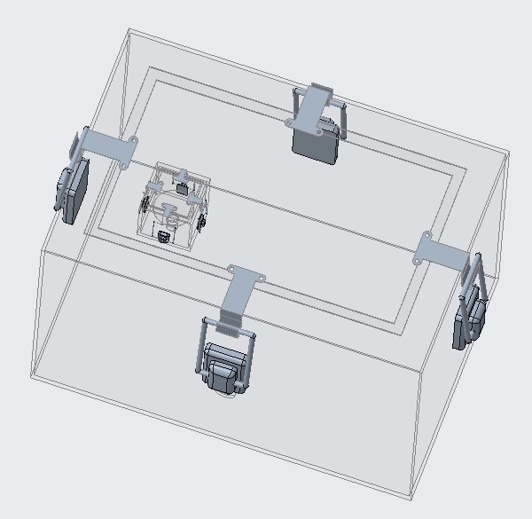
Design Concept: CAD Model
Peter Mougey
Main body 24 x 24 x 36 inches
Funnel enclosure 4 x 4 x 4 inches
Funnel built into box
Main body top and funnel enclosure top both completely removable
Both sandwiched with rubber gasket material
8 latches total
Funnel insert from funnel enclosure top
Secure funnel stopper
Notes:
Taalk about four latches securing the main body top and four securing the funnel enclosure top
Maybe a possible rubber insert in the circle of the funnel portiong for the funnel stopper to push down

Slide 17
Experiment Details: Preparation & Set Up
Peter Mougey
Camera set up
Captures entire box
4.5 feet from box
iPhone raised 9 inches from ground
UV light set up
Left, outside facing inward
Fans set up
3 inch from wall
Adjustable angles
Controlled velocity
Glove box set up
Rubber gasket components for seal security
Latches for top attachments
Safety
Goggles, lab coats, N95 masks, and gloves
Placing box in fume hood
Starting with dust settle
Disposal and cleaning
Wipe between runs
Wet materials for safer disposal

Slide 18
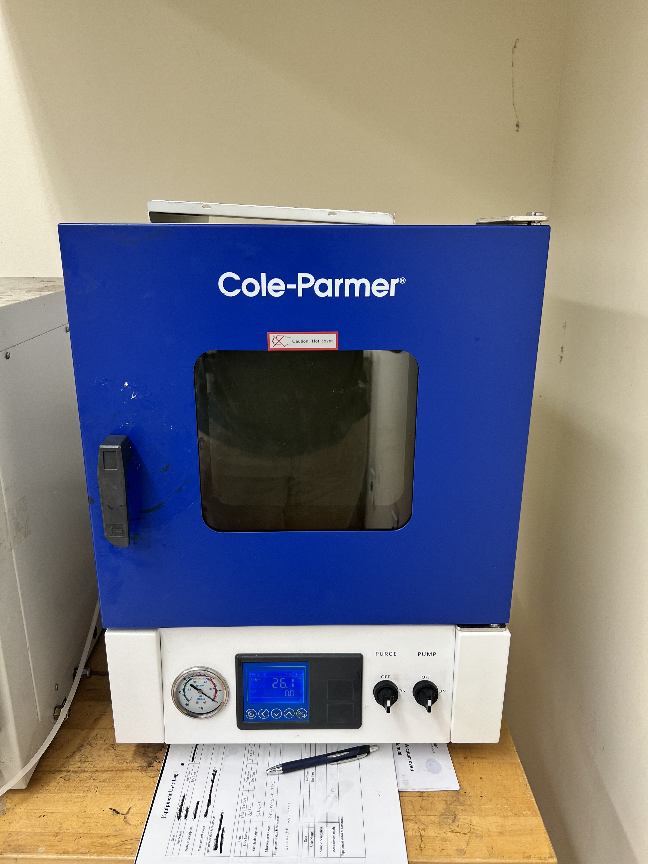
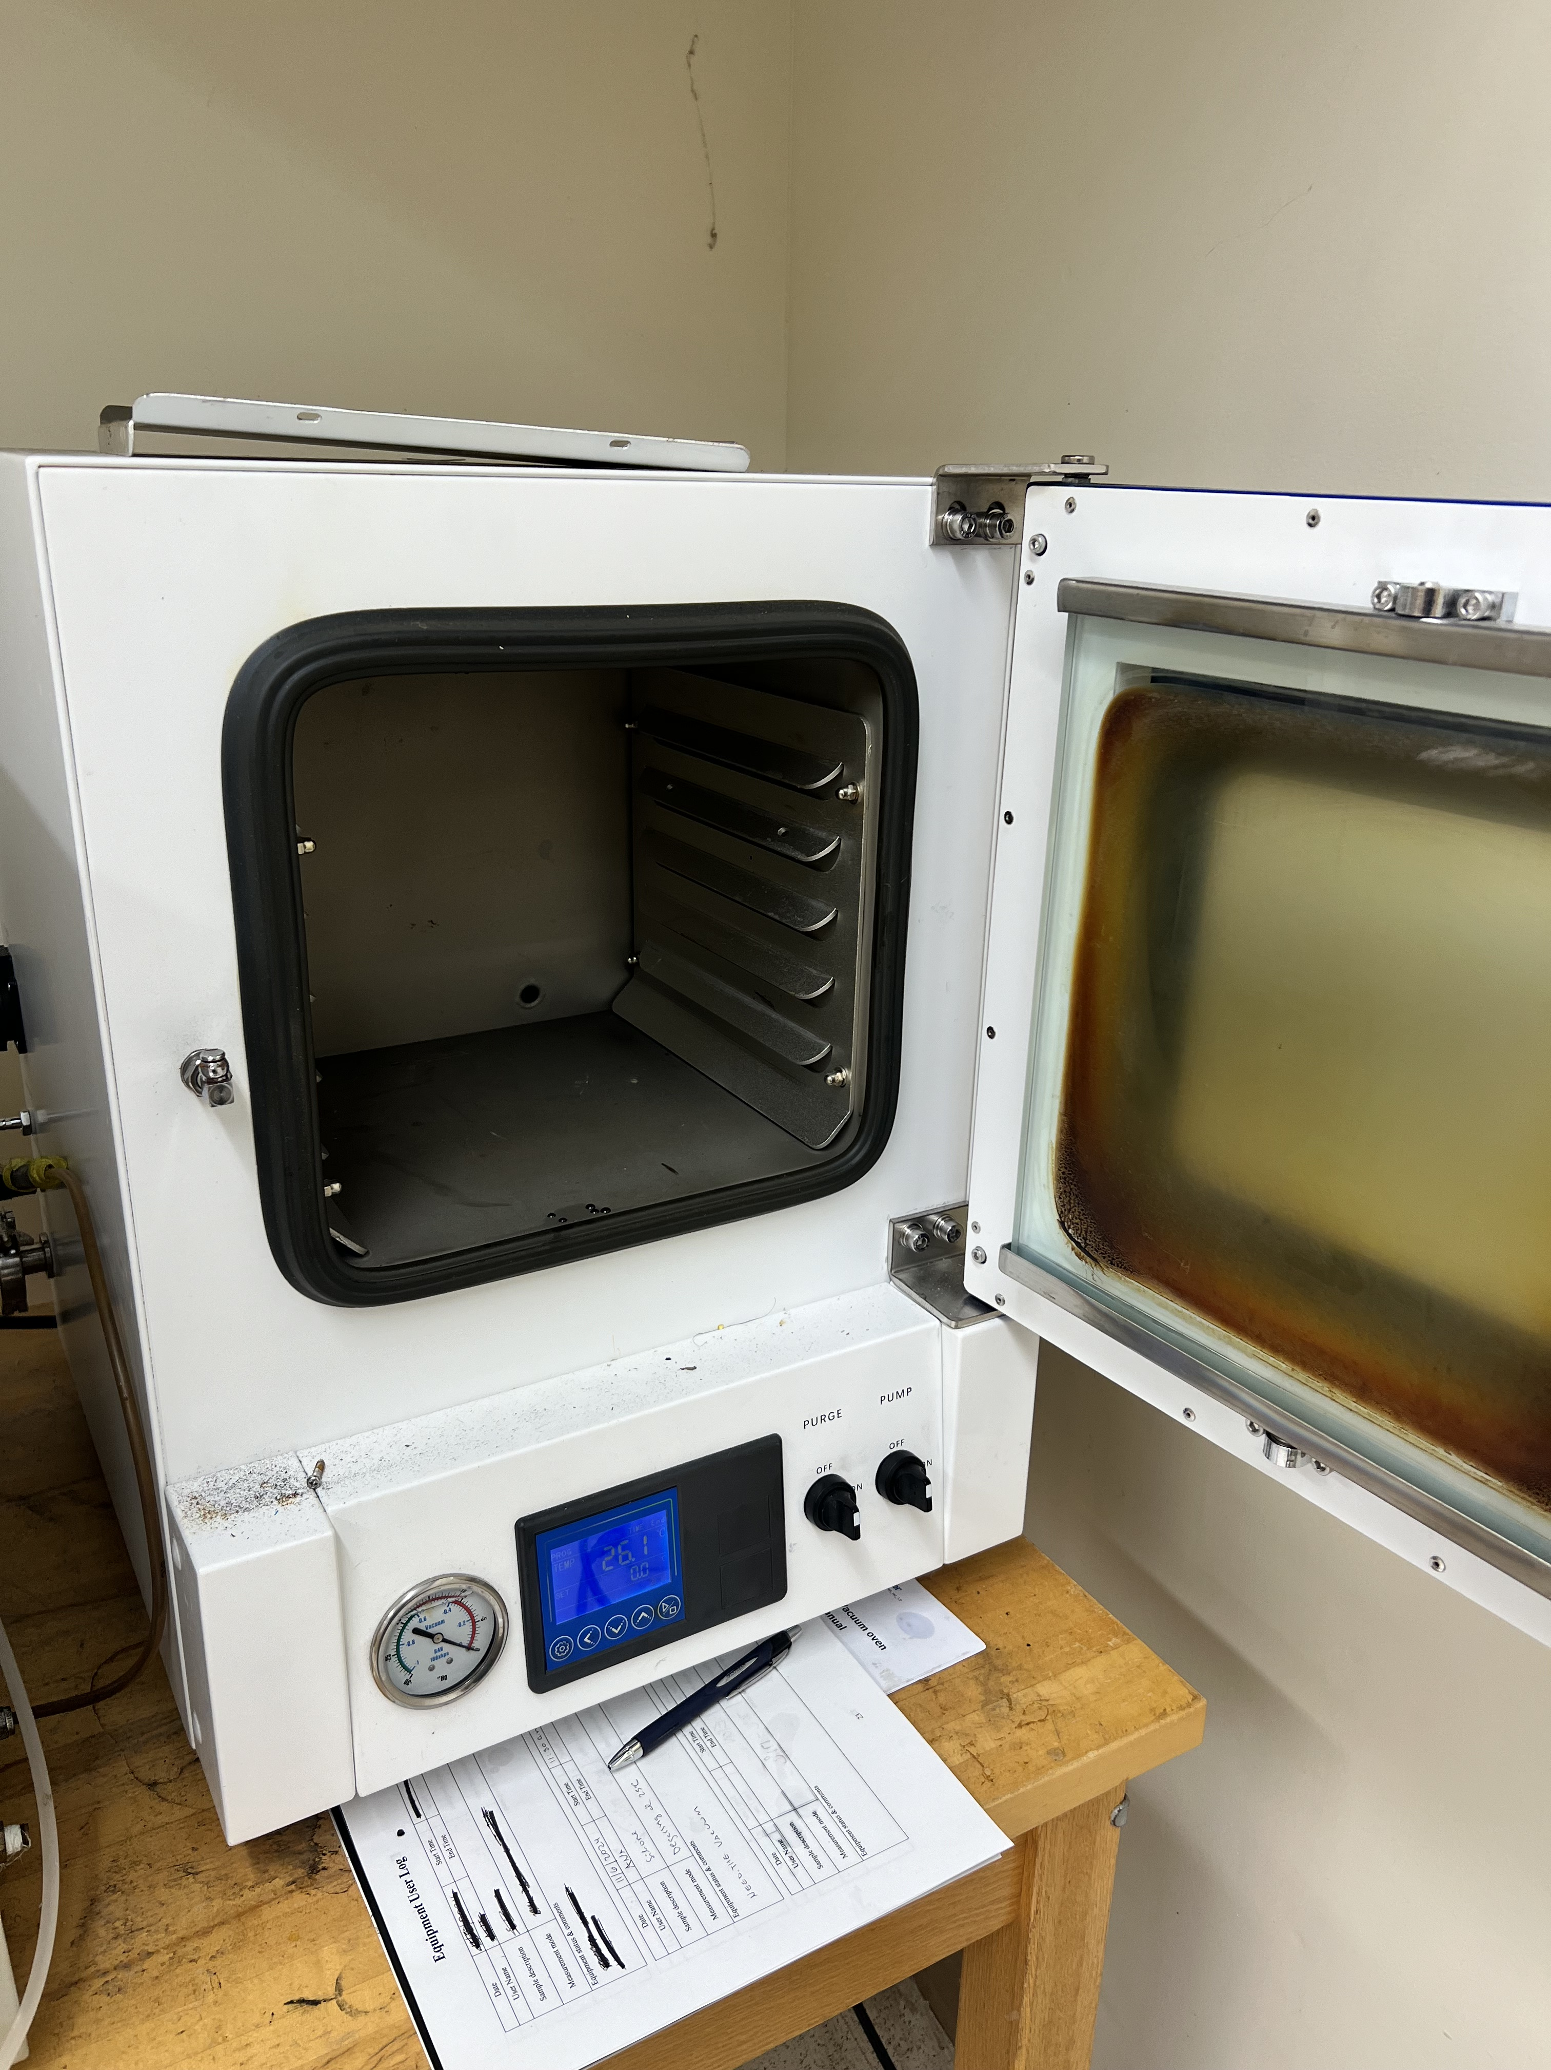
Experiment Details: Preparation & Set Up
Peter Mougey
12 hours
200 degrees C
NASA research
Ovens Room 124 at HPMI - Dehydrating Simulant
Notes:
200 degrees celsius is empirical based on NASA research
The 12 hours and 200 degrees cel are empirical from nasa research. This is in order to get all the water from all the porous surfaces within the particles. 100 degrees will not dehydrate the simulant like we need it too, and the drying process we plan to use will only change the density by 1 percent
NASA looked at mass loss in the material and how much changes. 200 is just what they have been empirically able to show works. Higher than 200 would alter the materials in there. No clay on lunar surface bc no water on lunar surface. So ideally want simulants that don’t have clay bc bc theyre on earth theyre exposed to water so they have clay minerals exposed which is not ideal and we dont want them there but are still there no matter what we do. When we bake at higher temperatures, those clay minerals are first thing that start to change. When we bake it gets them to the version out that we dont want but not too much to where they alter. 200 is in between value that gets that water out and takes some of clay out but not too much to where it alters way too much. Lower wouldnt get all surface bound water out. Might be intraporous spaces filled with water that will come to surface, so want to bake it out. 100 degrees will not be sufficient to do that. Doesn't have to be exactly 12 hours, they sort of just do overnight sort of thing where they leave materials overnight in oven and let it bake itself out.
Can bake it out and do pre and post mass calculations and see how mass changes with 15 hours vs 12 butwont be super different.
Baking wont change bulk density a lot bc maybe 1% water in materials. If 10% water then ye sit would change it

Slide 19
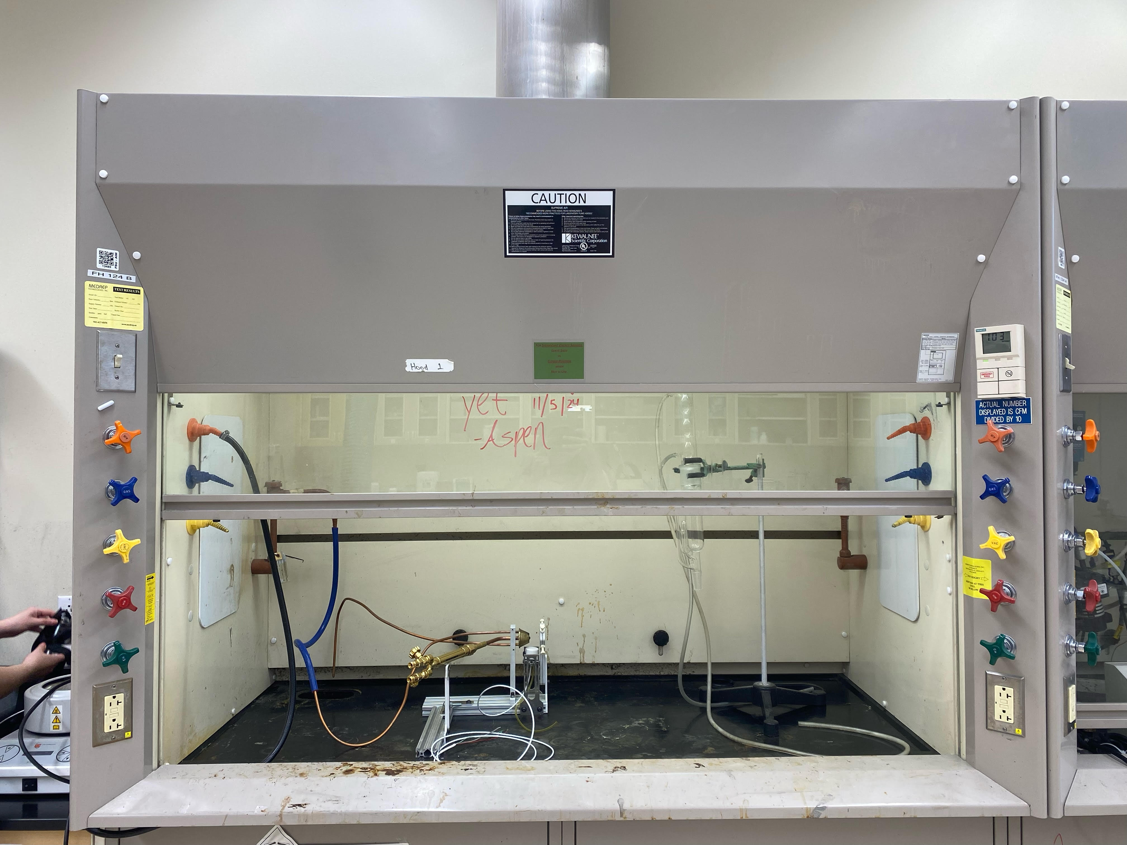
Experiment Details: Preparation & Set Up
Peter Mougey
Fumehood
→ Increase safety
→ Remove aerosolized particles
→ Reduce inhalation risks
Fumehood Room 124 at HPMI
Notes:
200 degrees celsius is empirical based on NASA research
Can bake it out and do pre and post mass calculations and see how mass changes with 15 hours vs 12 butwont be super different.
Baking wont change bulk density a lot bc maybe 1% water in materials. If 10% water then ye sit would change it

Slide 20
Experiment Details: UV Light Visualization
Ryan Dreibelbis
Notes:
-explain that these are hard to see with the naked eye
-click next slide so they shrink

Slide 21
Experiment Details: UV Light Visualization
Ryan Dreibelbis
Notes:
So in order to visualize how the lunar simulant is moving the glovebox, fluorescent beads and UV light will be used. (move to next slide)

Slide 22
Experiment Details: UV Light Visualization
Ryan Dreibelbis

Slide 23
Experimental Details: Photography & Image Analysis
Ryan Dreibelbis
Notes:
Video footage will be taken of the glovebox while it is being tested. The glove box will be split into sections. (move to next slides)

Slide 24
Experimental Details: Photography & Image Analysis
Ryan Dreibelbis

Slide 25
Experimental Details: Photography & Image Analysis
Ryan Dreibelbis
2
2
2
2
2
2
2
2
Notes:
Fluorescent beads inside will be analyzed by sections of the glovebox through image analysis

Slide 26
Experimental Details: Photography & Image Analysis
Ryan Dreibelbis
2
2
2
2
Evenly Distributed
2
2
2
2
Notes:
If the quantity of fluorescent beads in each section of the box are similar then the lunar simulant can be considered evenly distributed.

Slide 27
Experimental Details: Testing and Prototype Challenges
Ryan Dreibelbis
Challenge 1:
Challenge 2:
Challenge 3:
Vacuum testing prototype post build
Exceeding PSI limits
Leakage security
Preventing leakage into funnel enclosure
Built in funnel stopper
Taking different post processing route
No longer considering particle image velocimetry
Tools like ImageJ and Apple Pro Raw Images
Notes:
Preventing leaks is of paramount importance both to the success of the project as well as the safety of Team 516. Our first challenge regarding leakages will be vacuum testing the prototype after it has been built and being sure it does not exceed PSI limits. The second challenge regarding leakages discuss preventing material getting inside the funnel enclosure, which we plan to address by using a funnel stopper. Lastly, we are no longer planning to use PIV as our means of post processing, and are instead looking more towards image analysis tools such as ImageJ or Apple Pro Raw.

Slide 28
Simulation Details: CFD Progress and Analysis
Ryan Dreibelbis
Will be modeled as a multiphase flow
ANSYS CFX/Fluent
Currently adding lunar simulant particles to model
Matching the properties of simulant from targets and metrics
Discrete particle method
Track the movement of individual particles
Notes:
Current objective : Add lunar simulant particles to model. The particles must match the properties of simulant defined in the targets and metrics.
Using ANSYS Fluent, the particles will be modeled as a multiphase flow due to technological limitations. Discrete particle method will be the best method to track the movement of individual particles.

Slide 29
Simulation Details: CFD Current Assumptions and Simplifications
Ryan Dreibelbis
Steady, single-phase flow of air at 25°C
Transient multiphase flow
Fans modeled as inlets
Behavior complexities in the simulation
Perfectly spherical microparticles
Uniformly distributed
Initially settled on glovebox floor
Notes:
Initially a steady, single-phase flow of air at 25°C, progress to transient multiphase flow
Each fan is modeled as an inlet due to complexities of modeling fan behavior in the simulation
Microparticles will be perfectly spherical
Microparticles will be modeled as a uniformly distributed, settled layer on the floor of the glovebox initially

Slide 30
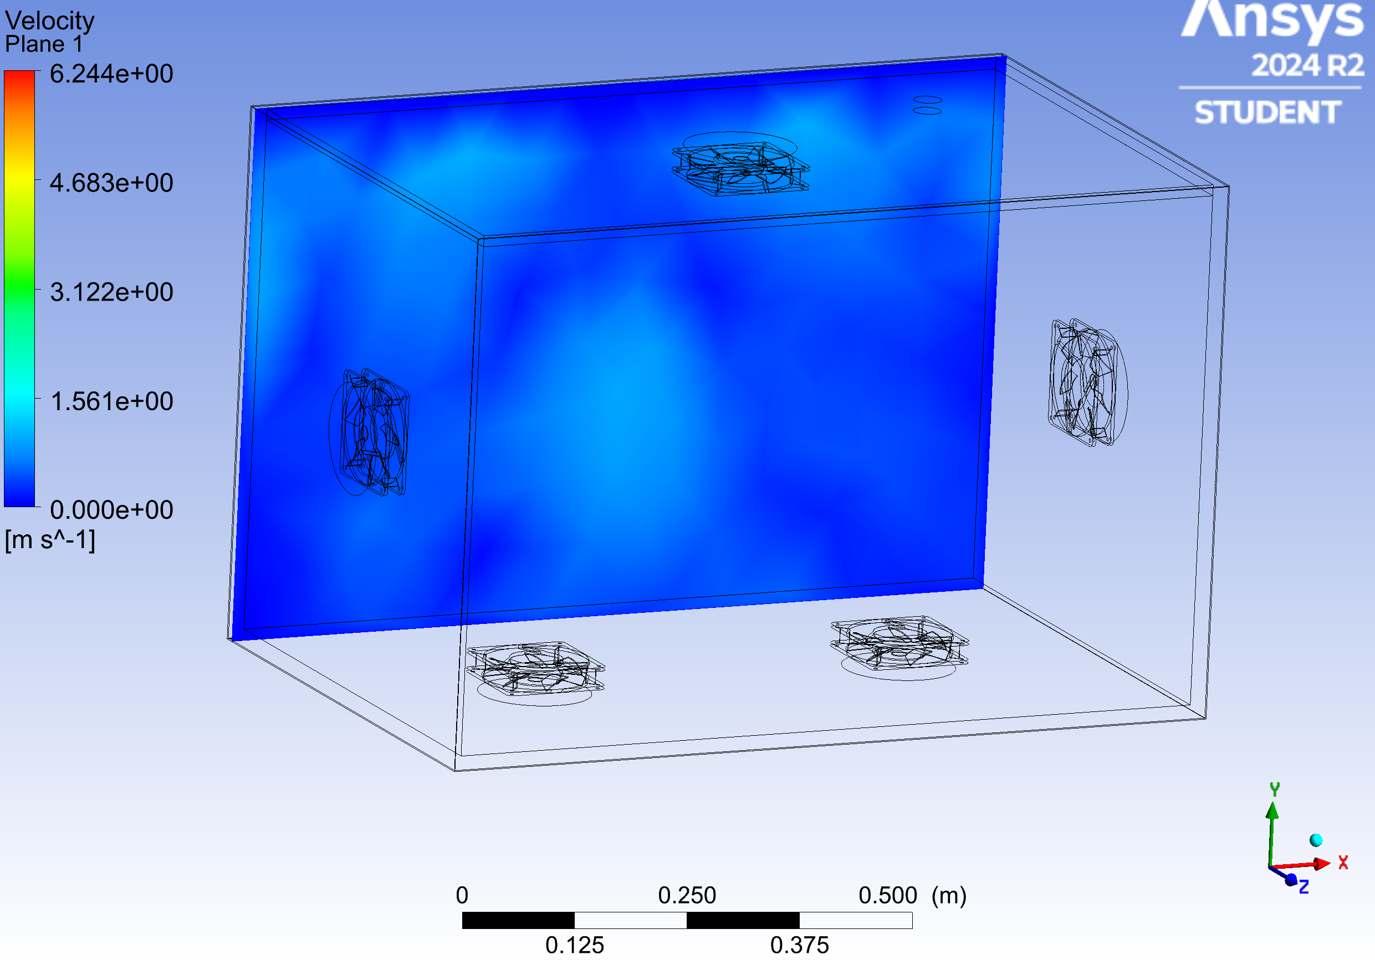
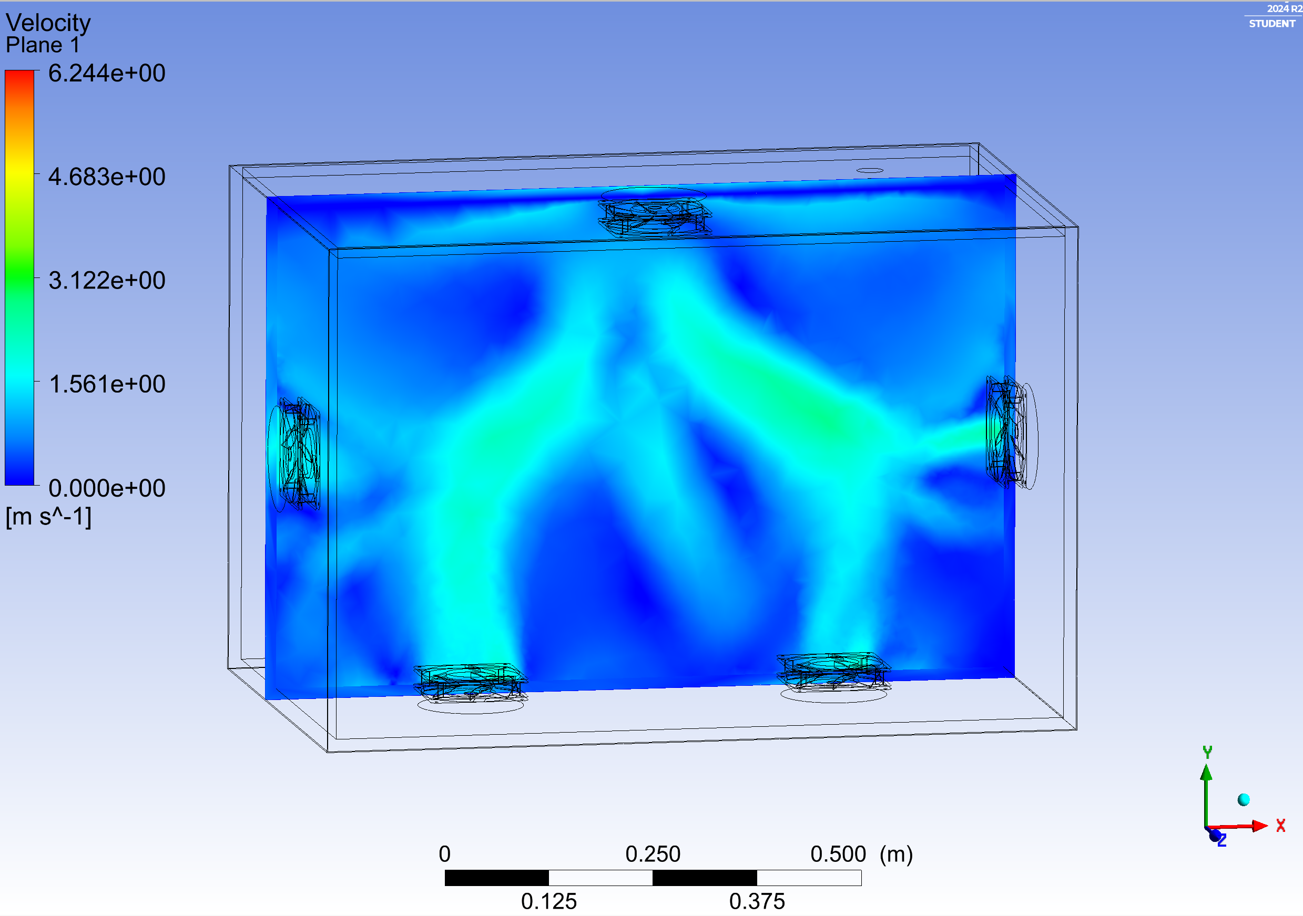
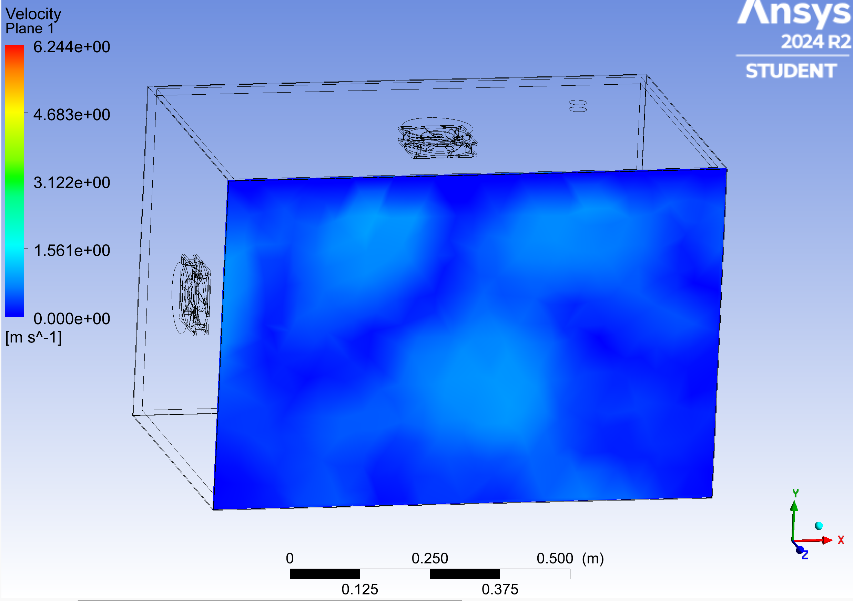
Simulation Details: CFD Progress and Analysis
Ryan Dreibelbis
Velocity contours of the airflow inside the glovebox
Corners of the glovebox experience airflow with low velocity
Not necessarily indicative that lunar simulant would be evenly distributed inside

Slide 31
Simulation Details: CFD Challenges
Ryan Dreibelbis
Challenge 1:
Challenge 2:
Challenge 3:
Sub Domains
Issues meshing with CFD solver
Necessary for ideal air properties
Heat generation in enclosed space
Estimating amount of heat
Fan power
2D or 3D animation
Issues generating a video showing the progression lunar simulant distribution
Notes:
Challenges: When meshing and running the CFD solver, there are issues with the chosen sub domains. The sub domains are necessary for the ideal air properties inside of the glovebox.
Challenges: Fans will blow inside of a closed box which will produce heat due to power consumption. Finding out/ estimating how much the temperature will be affected due to fan power.
Challenges:

Slide 32
Result Comparison: Analysis
Nia Britton
Project Completion
CFD software and image particle analysis results are mirrored
Distribution of the microparticles
Air blowing from the inlets (fans)
Results will determine the fan positioning
Actual air flow may have slight differences
Simplified fan behavior in simulation**
**Sponsors desire that the simulant microparticles mix evenly within the air flow inside of the box, which will then allow the simulant to distribute evenly within the geometry of the box.
Notes:
From the CFD simulation, we will able to see the distribution of the microparticles inside of the glovebox due to air blowing from the inlets or fans. We will use the cfd results to actually determine the fan positioning for the physical glovebox. We do understand that the actual air flow may behave slightly different from the simulations due to the simplified fan behavior used in the CFD model. We will be visually comparing the photography tools we use for the physical experiment (like Image J and Apple Pro Raw Images) to the visual simulation portion as far as particle distribution goes. Overall our sponsor want us to mix the simulant evenly within the glovebox’s geometry in the cfd and the real experiment.

Slide 33
Budget: Bill of Materials
Nia Britton
Item Description | Price | Qty.
¼ Inch Polycarbonate Sheet, 24 x 36 inch | 142.69 | 4
¼ Inch Polycarbonate Sheet, 24 x 24 inch | 104.99 | 4
LHS-1 | 125.00 | 1
LMS-1 | 125.00 | 1
Computer Fan | 18.99 | 10
Silicone Rubber Gasket Seal | 17.49 | 4
Most expensive items from procurement log
Polycarbonate sheets to be used for box, funnel, and funnel enclosure
A set of fans for each experiment run
Notes:
So here is a short table of our top priced purchases from our procurement log, including both sizes of polycarbonate sheets, both simulants we are testing, two sets of computer fans, and enough rubber gasket seal for all of the applications we plan to use it for.

Slide 34
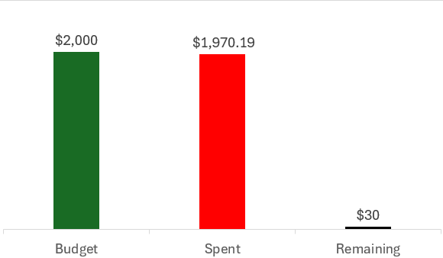
Budget: Bill of Materials
Nia Britton
2000 dollars allocated
98.5% of budget is planned to be used
Notes:
This is how much money we plan to use, and fortunately we are just within budget, maximizing our spending efficiency

Slide 35
Future Work
Nia Britton
Materials Delivery
1st Experiment Preparation and Execution
CFD Simulation Finalizations
Work Order Creation for Glovebox
Notes:
For fute work, next we want to have the cfd simulations finalized, wait on our materials to be delivered, create a work order for the machine shop once the materials come in, and prepare for and execute our first experiment run!

Slide 36
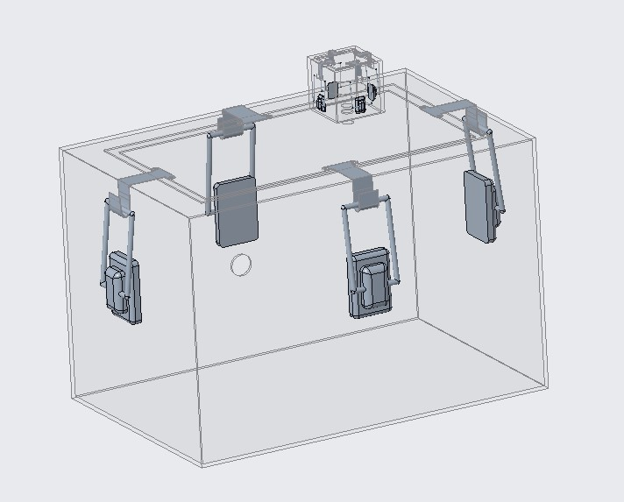
Thank You! Floor is open for any questions or feedback!
Nia Britton
Notes:
Thank you all so much for your time today. That completes our presentation and the floor is now open for any questions or feedback you all may have.

